Slide 1
Promoting Resilience
Lora Peppard, PhD, DNP, PMHNP-BC

Slide 2
Objectives
Define and characterize the concept of resilience.
Review evidence-based strategies to promote resilience.
Translate evidence-based strategies into actionable items.

Slide 3
What is Resilience?
Definition
Adapting well in the face of trauma, adversity or significant stress
Dynamic process of personal negotiation through life
Contextual and multidimensional
Variable across time and circumstance
Involves thoughts, behaviors, and actions that anyone can learn and develop AND any organization or community can PROMOTE

Slide 4
Individual Resilience
Internal Locus of Control | Perseverance | Emotional Management & Awareness | Optimism | Perspective | Self-Efficacy | Sense of Humor | Ability to Problem Solve
Internal Attributes (Personality/individual characteristics)
Environment (External factors such as social support)
What can be drawn and learned from the best to be found in the environment (family, school, community).
Person-Environment – Product of both combined

Slide 5
10 Ways to Enhance Resilience
Make connections.
Avoid seeing crises as insurmountable.
Accept that change is a part of living.
Move toward your goals.
Take decisive actions.
Look for opportunities for self-discovery.
Nurture a positive view of yourself.
Keep things in perspective.
Maintain a hopeful outlook.
Take care of yourself.
5

Slide 6
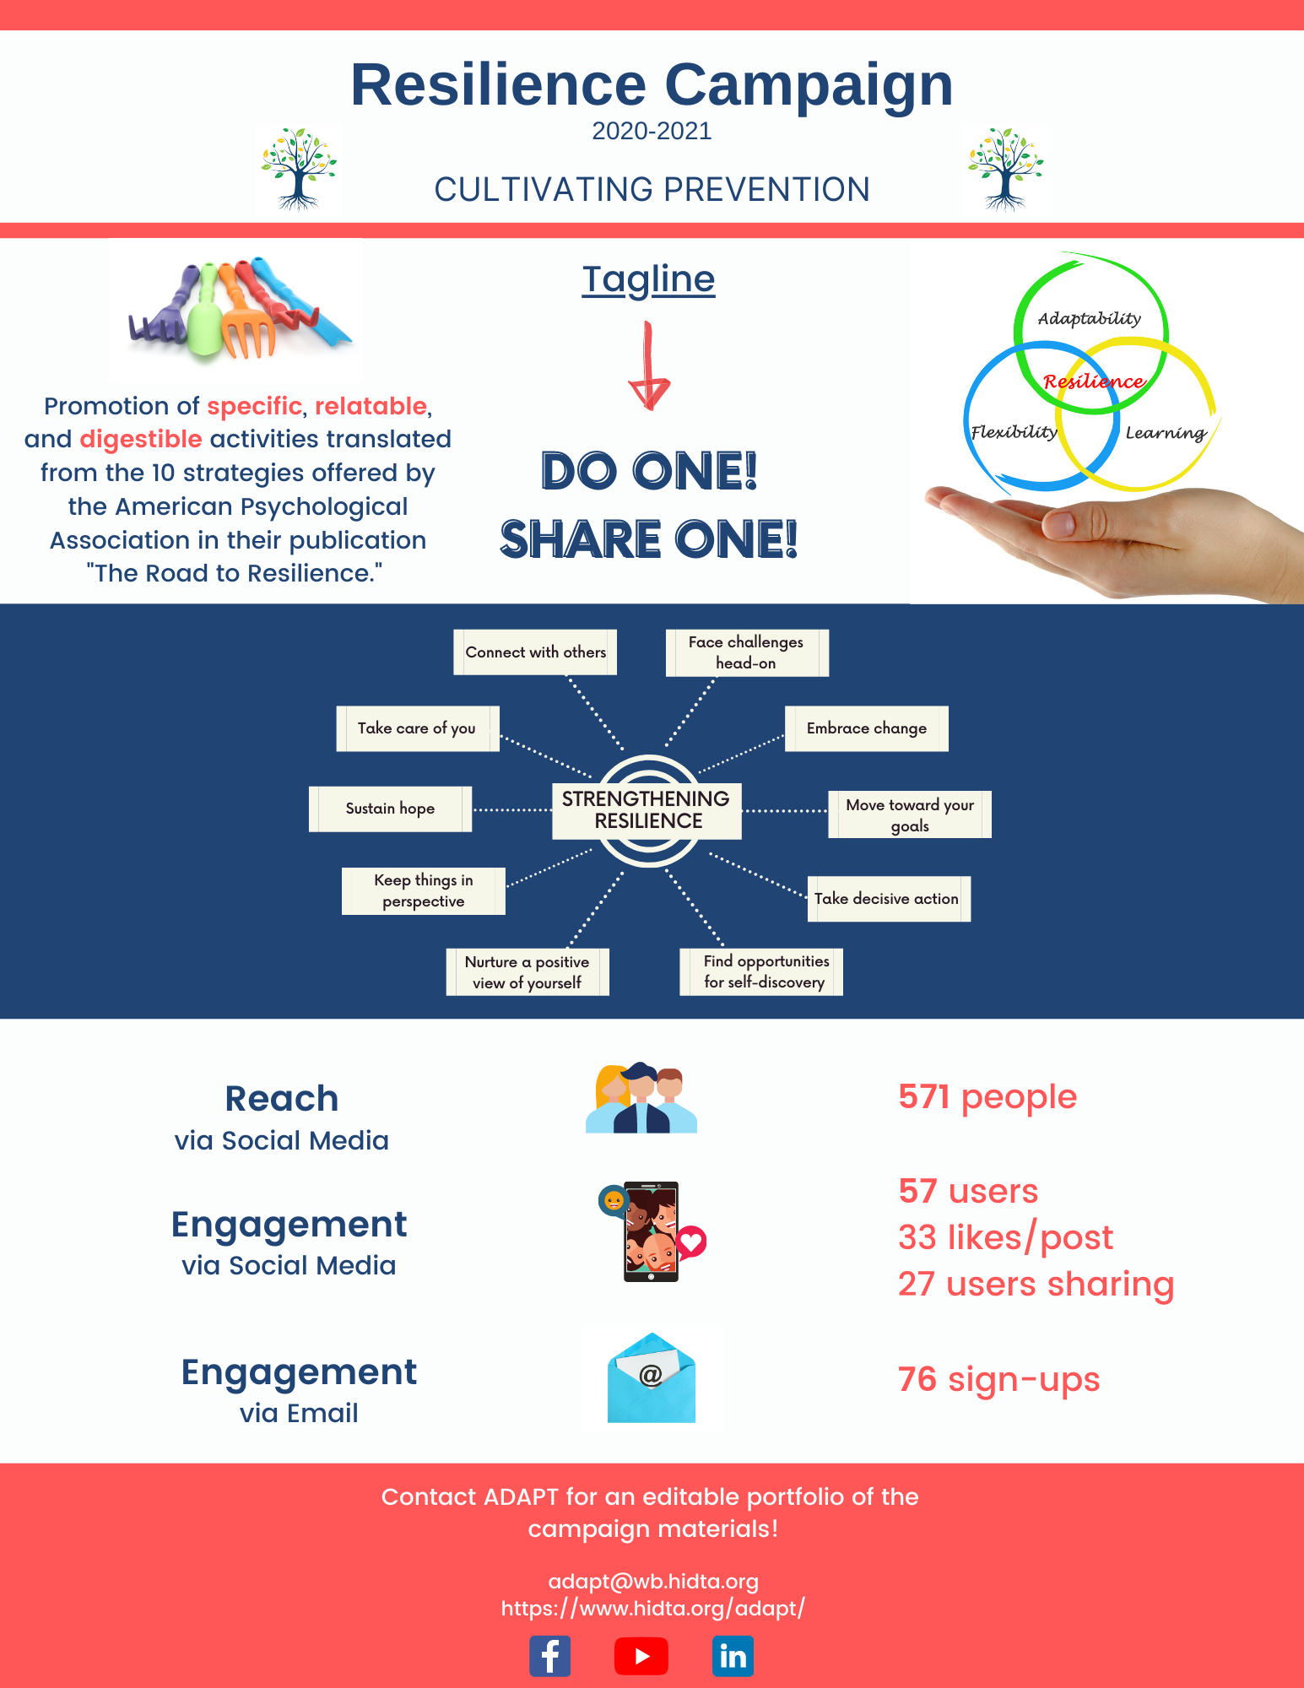
Resilience Campaign 2020-2021
DO ONE! SHARE ONE!
10 week campaign
Platforms: Social media and Email
Framework: APA Ways of Enhancing Resilience

Slide 7
Evidence-based Strategies & Tools
American Psychological Association
Positivepsychology.com
Mindful.org
10 Ways of Enhancing Resilience
10-ways-to-build-resilience.pdf (stanford.edu)
17 science-based resilience building activities
23 Resilience Building Tools and Exercises (+ Mental Toughness Test) (positivepsychology.com)
Remodel the brain
How to Cultivate the Resources for Resilience - Mindful

Slide 8
Organizational Resilience
‘A resilient organization effectively aligns its strategy, operations, management systems, governance structure and decision support capabilities so that it can uncover and adjust to continually changing risks, endure disruptions to its primary earnings drivers, and create advantages…’.
(Starr et al 2007)
Focus is different: Individuals + Processes + Culture
How well can an organization “weather the storm”
The greater the diversity of resilience strategies available to an organization, the greater its ability to respond to challenges = bigger buffer
Risk management provides a good framework to be proactive in managing the unexpected
Job design – demands, control, motivators or rewards
Organizational culture and structure
Leadership – Engaging, supportive styles influence resilience in employees
Systemic/external environment – Social and institutional support key at every level, promotion of networks of successful relationships

Slide 9
Translation for First Responders
Activities need to be:
Relatable
Digestible
Enhanced through organizational support
(Relatability + Digestibility) ^{Support} = ↑ Likelihood for Successful Integration

Slide 10
Growth Mindset & Measuring Individual Resilience
Resilience interventions improve psychosocial functioning and facilitate a growth mindset (Robertson et al., 2015; Rendon, 2015)
Connor Davidson Resilience Scale (CD-RISC) - measure of personal competence, acceptance of change, secure relationships, and control influences
Recognized as a sound measure of resilience and practical for the workplace due to its speed of completion (Lauridsen, Willert, Eskildsen, & Christiansen, 2017)
CD-RISC: About (cd-risc.com)

Slide 11
Measuring Community Resilience
A defining characteristic of community resilience is multidimensionality.
The resilience of a community encompasses all of the resources and assets available in the community.
Calculating for an Adequate System Tool (CAST)
Produces community-specific assessments of the capacity of the components of a community substance abuse care system along the continuum of care
Generates recommendations by the application of social and community determinants of health as risk coefficients to each estimate of component need
Community leaders can use CAST to prioritize resource allocation more effectively and efficiently(Green et al., 2016)

Slide 12
Quote and Image Slide
“
Do One. Share One. Build One.
12

Slide 13
Thank you!
Lora Peppard, PhD, DNP, PMHNP-BC
lpeppard@wb.hidta.org
www.hidta.org/adapt

