Slide 1
WWII and The Baloo
An exploration of the history of the University of Baltimore through archived publications

Slide 2
Irvin Hillman
“Czar of the publications”
Notes:
Hillman - 04/15/1942 Yearbook Photo

Slide 3
“Still the Baloo madhouse continues in its incessant babbling of meaningless jumble. A typical few moments:”
“...Another ten minutes of Baloo Office chatter has been inscribed for history.”
Notes:
The Baloo as a lively place for discussion - 02-26-1941

Slide 4
Notes:
Chesterfield Cigarettes & Wrigley Chewing Gum (both from 11/27/1940)

Slide 5
Notes:
Chesterfield Cigarettes & Wrigley Chewing Gum (05/07/1941 & 10/23/1940)

Slide 6
Notes:
(12/4/1940 & 11/19/1941)

Slide 7
“There are, this manufacturer explains, many good substitutes for wrappers, but there are no substitutes for aluminum in airplanes.”
Notes:
(11/05/1941 issue - Wrigleys Change Packaging & Stockings/silk cotton

Slide 8
“[The] purpose of the club is to convince campus women that this army needs parachutes worse than girls need silk stockings.”
Notes:
Wrigleys Change Packaging & Stockings/silk cotton - 09/24/1941

Slide 9
“Red, white, and blue cotton stockings are the ‘rage’ in the eastern collegiate set.”
“America needs the silk that American women put on their legs.”
Notes:
Wrigleys Change Packaging & Stockings/silk cotton - 10/08/1941

Slide 10
“The Grill too had its quota of students who sat by listening as history was being made.”
Notes:
War Message - 12/10/1941 - Transition to talking about

Slide 11
“Each day another classmate in our midst is taken from his books and given a gun in the Draft Army of the United States.”
Notes:
10 - 15 - 1941

Slide 12
“Today 75 per cent of the squad has been taken into the Army, hence it is inevitable that the freshmen must be considered as prospective candidates for the 1941 squad.”
Notes:
Freshman Sports Rule Changed

Slide 13
“It is necessary that the freshman rule will be dropped during this National Emergency, but will be reinstated when things settle down a bit.”
Notes:
Freshman Sports Rule Changed

Slide 14
“Several openings still remain on the 1941-1942 Maroon Bee.”
“All students, day or night, that wish to write, vist the Publications Office for an assignment.”
Notes:
Baloo call for staffing

Slide 15
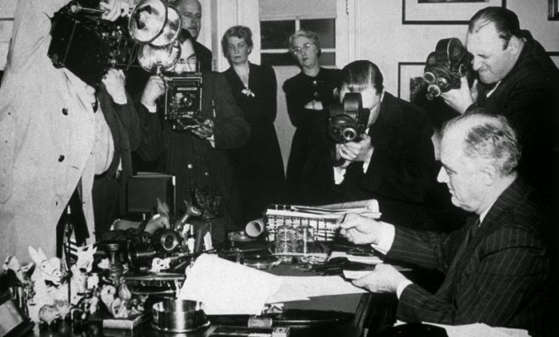
The Lend-Lease Bill
Notes:
Source: http://orientalreview.org/wp-content/uploads/2015/05/president-roosevelt-signs-the-lend-lease-bill-at-the-white-house-in-1941.jpg

Slide 16
“Few bills in U.S. History have accomplished as much as this one already has. For not only has the Lease-Lend Bill enabled the President to ship supplies to England gratis, but it has affected the American public even more directly.”
Notes:
Perspectives on going to war/US role: What did the UB student body think of America’s (pending) involvement in WWII? What did they think of conscription? How did they justify their positions? 03-19-1941

Slide 17
“For the first time since 1918 the United States was awakened to the facts of life. She was told that she is a world power and can’t get around it.”
Notes:
Perspectives on going to war/US role: What did the UB student body think of America’s (pending) involvement in WWII? What did they think of conscription? How did they justify their positions?

Slide 18
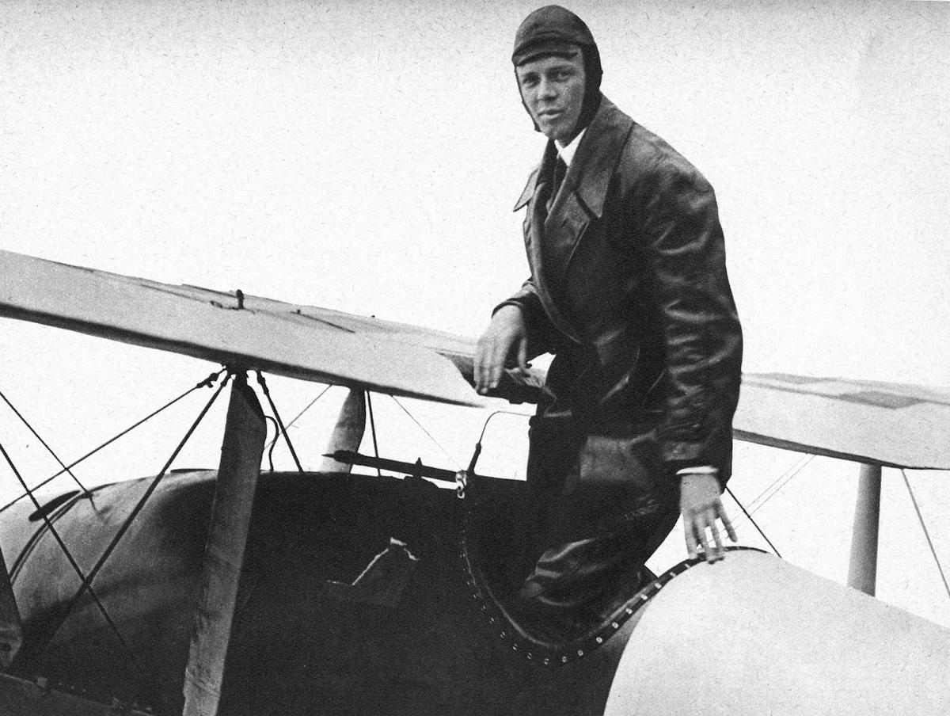
Charles Lindbergh
Notes:
First solo flight over atlantic, America first committee

Slide 19
Notes:
Interventionism con’t 2-19-1941

Slide 20
“A war economy means more than a huge army and a navy of gargantuan proportions. If economic chaos and social degeneracy is to be prevented, America needs trained and educated men.”
Notes:
Conscription 11-5-1941

Slide 21
“What do you think of making it compulsory for the physically fit to donate their blood to the Red Cross Blood Banks?”
Notes:
Blood Drive 2-18-1942

Slide 22
Irvin Hillman
1921-1942
Notes:
Hillman - 04/15/1942

Slide 23
“We, the graduates of the University of Baltimore...hereby dedicate this, our yearbook, THE REPORTER, to those of our number who now sleep in the graves dotting this world in order that we might reach this pinnacle of achievement in life.”
Notes:
Freshman sports ban lifted Reporter 1946

Slide 24
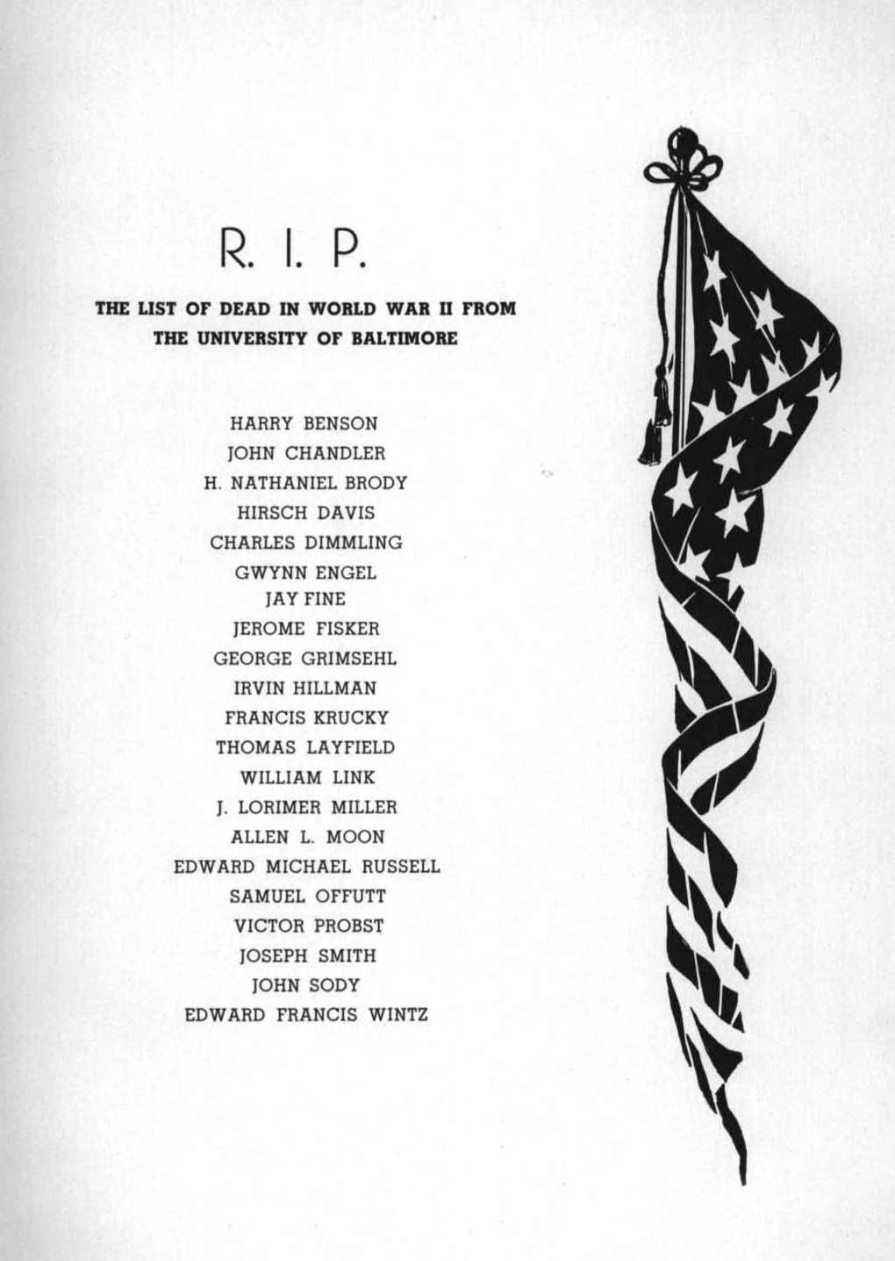
Notes:
Students who died in war

Slide 26
Acknowledgements
Thank you to Professor Nix and the University of Baltimore Special Collections

