Slide 1
Augmented Reality Guidance & Operating System
Project A.R.G.O.S.
The PoeGrammers

Slide 2
NASA SUITS
-Design/Coding Challenge presented by NASA
-Create an Augmented Reality User-Interface to be used by Astronauts during EVA
-Designed to walk the user through an unfamiliar task

Slide 3
The PoeGrammers
Juan Pablo Soto: Project Manager
-Larysa Paliaschuk: UI Designer/Programmer
-Eric Ra: 3d Modeler and Animator
-Osman Martinez: Android Design/Programmer
-John Manlucu: Network and Communications Manager
-Karl-Heinz Gilbert-Wason: UI Programmer and General Development
-William Hyland: Interaction Designer/Programmer

Slide 4
Design Challenges
-Suit Data/Biometric Data must ALWAYS be accessible to the User
-The User must be able to complete the task at hand with or without assistance from ground control
-The User must be able to interact with the UI despite being in a restrictive space suit

Slide 5
Our Design
-Minimalist UI
-Manual Pages/Animations
-Multi-Modal Interaction
-Remote Assistance Application

Slide 6
Minimalist UI

Slide 7
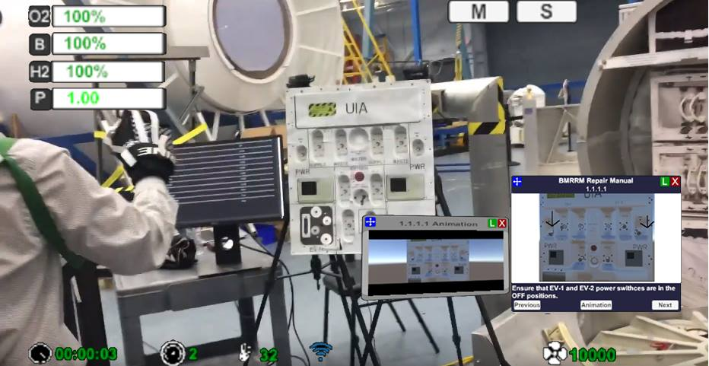

Slide 8
Goals
-Present Telemetry To User
-Keep Field of View Clear for Maintenance
-Reduce Cognitive Load for The User

Slide 9
Manual Pages & Animations

Slide 10
Manual Page with Animation

Slide 11
Goals
-Provide Step-By-Step Instruction
-Repositionable Doc Keeps View Clear for The User
-Animations Provide a Visual Reference

Slide 12
Multi-Modal Interaction

Slide 13
Multiple Modes of Interaction
Gesture Mapping
Eye Tracking
Remote Assistance Application

Slide 15
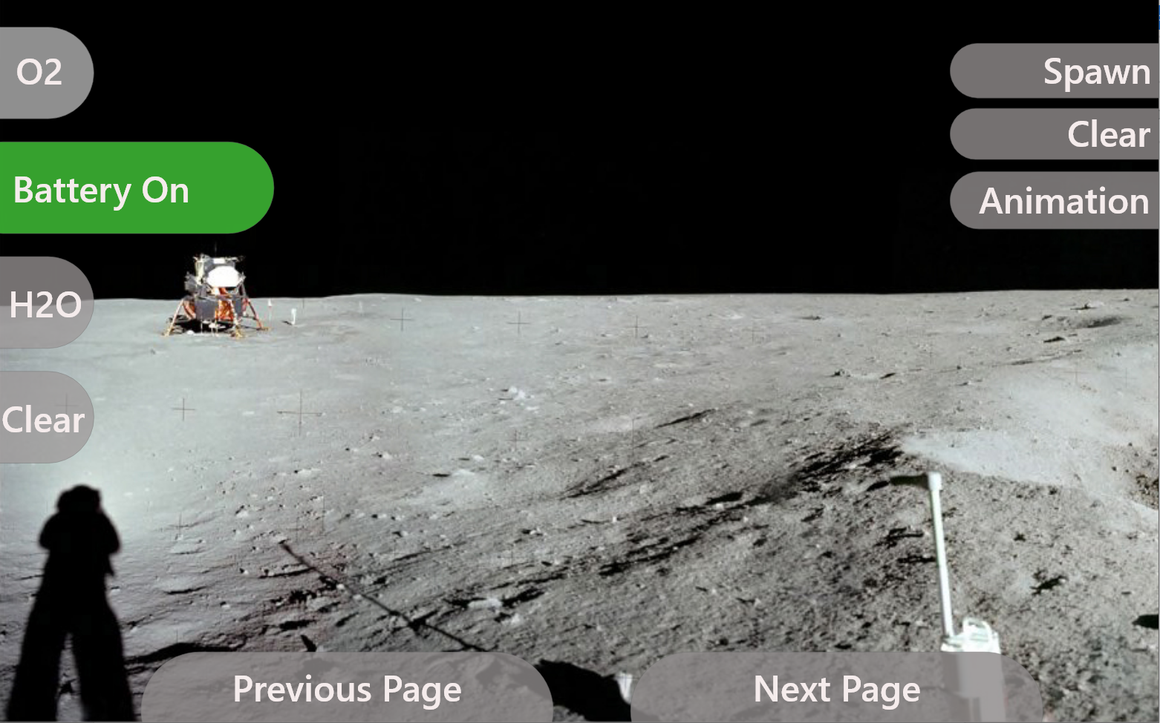

Slide 17
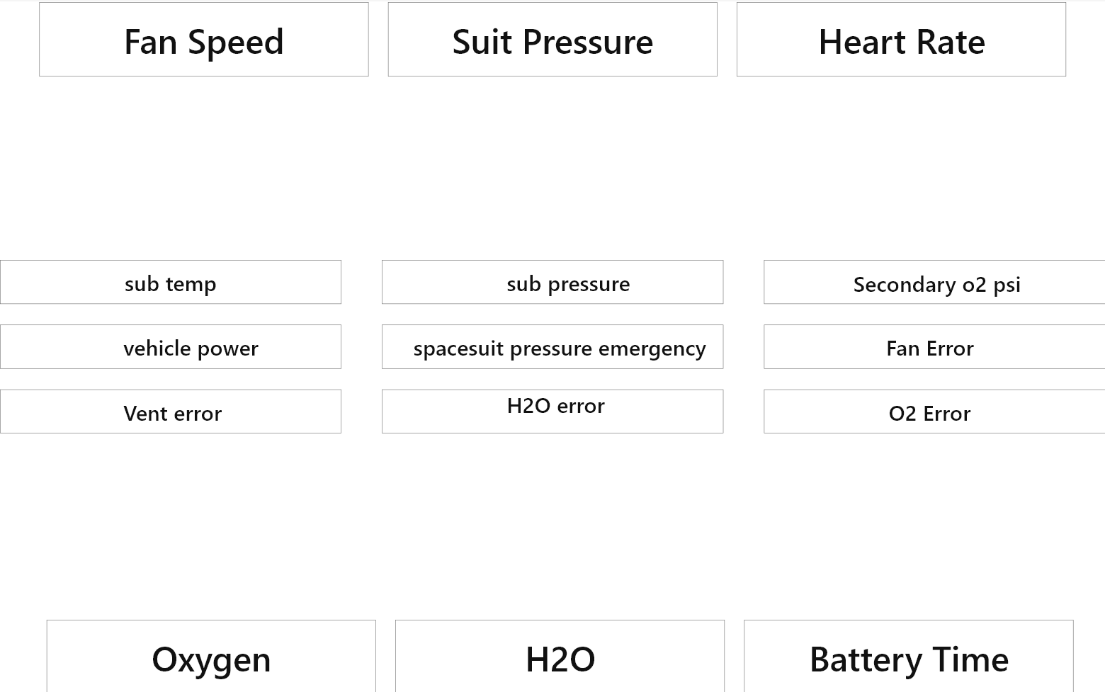

Slide 18
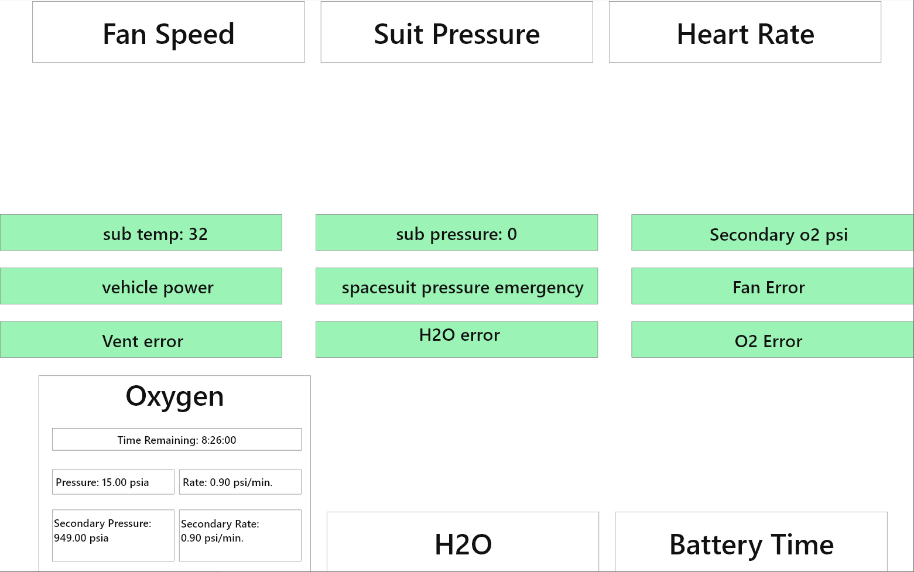

Slide 19
Test Week

Slide 20
Testing
Headset
-Teach Instructor How to interact with UI
UI
-Allow User to Complete task using UI
Remote App
-Use Remote Assistance Application to Aide Task

Slide 21
Testing Day 1

Slide 22
Fix Bugs

Slide 23
Testing Day 2

Slide 24
Success!

Slide 25
Conclusion
-Minimalist UI
-Multi-Modal Interaction
-Remote Assistance Application
-Successful Completed Task Using Our UI

Slide 26
Thank You!

